Slide 1


Road Signs Classification using CNN
BY:
G. Mahalaksmi
DADS- Feb Online Batch- 2025

Slide 2
Introduction
Road signs are vital for traffic safety.
Automated recognition is important for autonomous vehicles.
This project builds a Convolutional Neural Network (CNN) to classify road signs.

Slide 3

Objectives
Develop a CNN model for road sign classification.
Evaluate model performance with standard metrics
Deploy a user-friendly Streamlit app for real-time predictions.

Slide 4
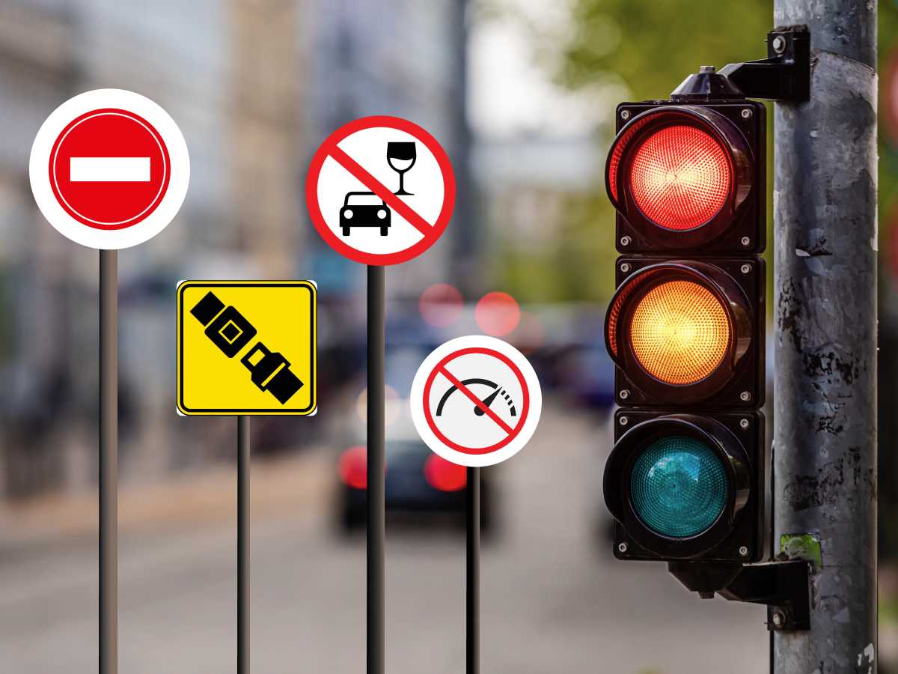
Dataset Description
Road sign dataset with 43 classes.
Images resized to 32×32 RGB.
Data split: 60% Training, 20% Validation, 20% Testing.
Applied data augmentation (rotation, flipping, scaling).

Slide 5
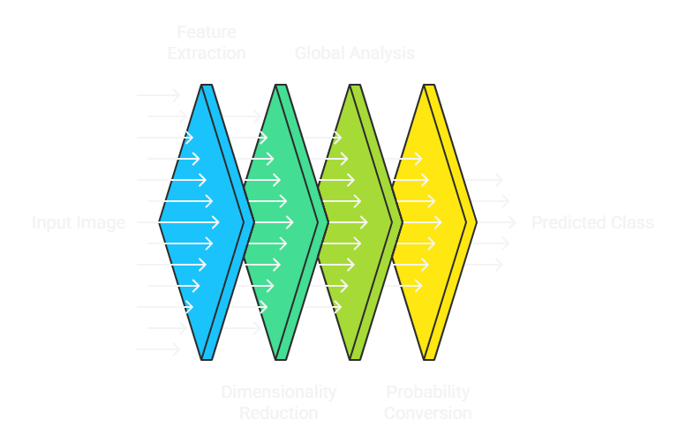
Model Architecture (CNN)
Input: 32×32×3 images.
Layers: Convolution + Pooling → Dense → Softmax.
Activation: ReLU (hidden), Softmax (output).
Optimizer: Adam.
Loss Function: Categorical Cross-Entropy.

Slide 6
Model Evaluation
Accuracy: ~95%.
Metrics: Precision, Recall, F1-Score.
Confusion Matrix shows high performance
across most classes.

Slide 7

Results & Insights
CNN accurately classifies 43 road sign classes.
Performs well on unseen test images.
Minor confusion between similar signs (e.g., speed limits).

Slide 8

Deployment (Streamlit App)
Developed Streamlit-based UI.
Upload road sign image → Get prediction + confidence score.
Example: Input = STOP sign → Output = “Stop (99.2%)”.

Slide 9

Future Improvements
Train on larger & diverse datasets.
Apply transfer learning (ResNet, VGG).
Extend deployment to mobile apps for real-time detection.

Slide 10
Thank You

